Slide 1
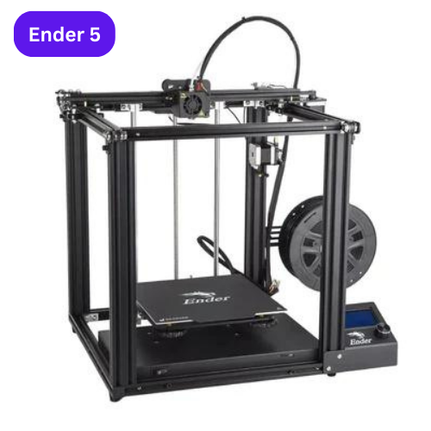
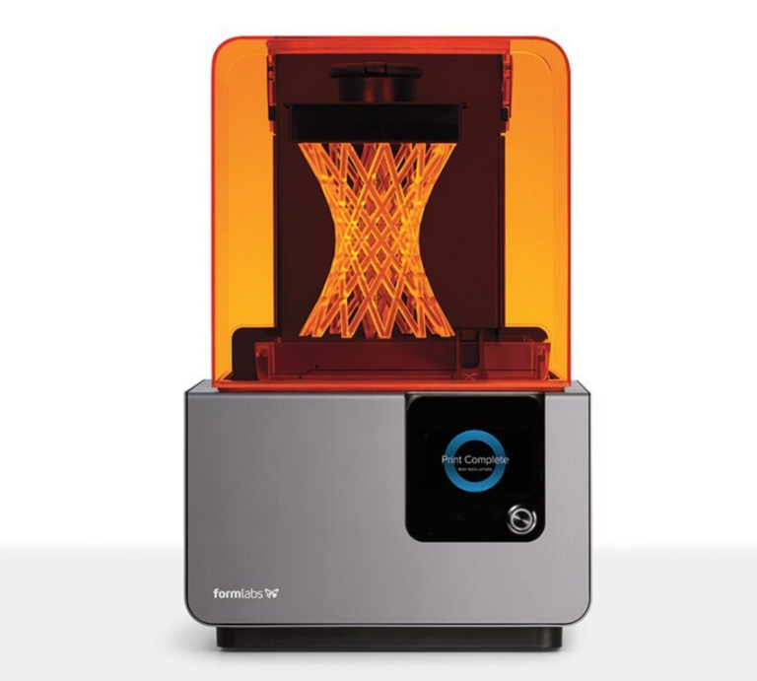
3D Printing Technology

Slide 2
What is 3D Printing?
Definition: Additive manufacturing process creating three-dimensional objects layer by layer.
Historical background: Introduction in the 1980s and evolution over the years.

Slide 3
How Does 3D Printing Work?
3D printing, also known as additive manufacturing, is a revolutionary manufacturing technology that allows the creation of three-dimensional objects layer by layer, based on a digital model.
The process involves several key steps, each contributing to the precision and customization that define 3D printing:
Digital Design: The 3D printing process begins with a digital 3D model created using computer-aided design (CAD) software.
Slicing the Model: The digital model is sliced into thin, horizontal layers using specialized software. It also generates a program in G & M codes that 3d printer can understand and execute the printing.
Material Selection: Various materials can be used in 3D printing, including plastics, metals, ceramics, and even bio-compatible materials.
Layer-by-Layer Building: The 3D printer reads each sliced layer of the digital model and builds the physical object layer by layer.
Support Structures (if needed): Some 3D printed objects may require support structures during printing to prevent overhangs and ensure stability.
Post-Processing: Removing support structures, surface finishing, and additional treatments like painting or coating.

Slide 4

Impact Of 3D Printing Technology
Healthcare: Medical implants, prosthetics, customized surgical tools.
Aerospace: Prototyping, manufacturing lightweight components.
Automotive: Rapid prototyping, custom parts production.
Architecture: Scale models, building components.
Consumer Goods: Customized products, fashion accessories.
Education: Enhancing learning through tangible models.

Slide 5
Types of 3D printing technologies
Fused Deposition Modeling (FDM)
Stereolitho-
graphy (SLA)
Selective Laser Sintering (SLS)
Multi Jet Fusion (MJF)
Binder Jetting
Digital Light Processing (DLP)

Slide 6

Advantages of 3D Printing
Rapid Prototyping: Accelerated product development cycles.
Customization: Tailoring products to individual needs.
Cost-Effective: Reduced material waste and production costs.
Complexity: Ability to create intricate designs and geometries.
On-Demand Production: Manufacturing products as needed.

Slide 7

Innovations in 3D Printing
4D Printing: Objects that can change shape or functionality over time.
Bioprinting: Printing human tissues and organs for medical purposes.
Metal 3D Printing: Advancements in printing metal components.
Continuous Printing: Continuous production of large-scale objects.

Slide 8
Future Trends in 3D Printing
Industry 4.0 Integration: 3D printing in smart factories.
Artificial Intelligence: AI-driven design optimization.
Space Exploration: 3D printing in space for on-demand manufacturing.
Sustainable Materials: Eco-friendly printing materials.

Slide 9
Conclusion
3D printing stands at the forefront of a transformative technological revolution, offering a paradigm shift in manufacturing and design.
Throughout this presentation, we have delved into the myriad applications and benefits of 3D printing, from rapid prototyping to personalized healthcare solutions and sustainable manufacturing practices.

